Slide 1
The implications of emerging technology: Urban Air Mobility
STP601 Yunji Woo

Slide 2
Urban Air Mobility(UAM)
Safe and Efficient aviation transportation system that will use highly automated aircraft that will operate and transport passengers or cargo at lower altitudes within urban and suburban areas
UAM will be composed of an ecosystem that considers the evolution and safety of the aircraft, the framework for operation, access to airspace, infrastructure development, and community engagement.
1) Operation of aircraft systems
2) It takes place above urban areas

Slide 3
Definition of Urban Air Mobility
EASA(2021): “Urban Air mobility is a new air transportation system for passengers and cargo in and around densely populated and built environments, made possible by electrical vertical take-off and landing aircraft(e-VTOL) equipped with new technologies such as enhanced battery technologies and electric propulsion”
FAA & NASA(2020): UAM is a subset of Advanced Air Mobility(AAM), latter supports drone operations carried out between urban and rural environments, and the former is only focused on passenger and cargo operations within an urban environment.

Slide 4
2018 UAM Blueprint
2019 Honeywell
2020 FAA and NASA : FAA NextGen
ConOps
2020 Embraer and Airservices Austrialia UAM Conops v1.
2021 EASA ConOps
Definition of Urban Air Mobility
2012
2014
2016
2018
2022
NASA UTM project
소제목을 입력하세요
Airbus UAM BluePrint
K-UAM Roadmap
Drone, ~~
프랑시스 가득 버리었습니다. 이 이름을 릴케 그러나 까닭이요, 까닭입니다.
Passenger and cargo flight
Korean UAM Roadmap
2015
2017
2019
2019
소제목을 입력하세요
소제목을 입력하세요
소제목을 입력하세요
하나에 풀이 무성할 언덕 벌레는 둘 버리었습니다. 이웃 이네들은 벌써 우는 자랑처럼 불러 듯합니다.
하나에 풀이 무성할 언덕 벌레는 둘 버리었습니다. 이웃 이네들은 벌써 우는 자랑처럼 불러 듯합니다.

Slide 5
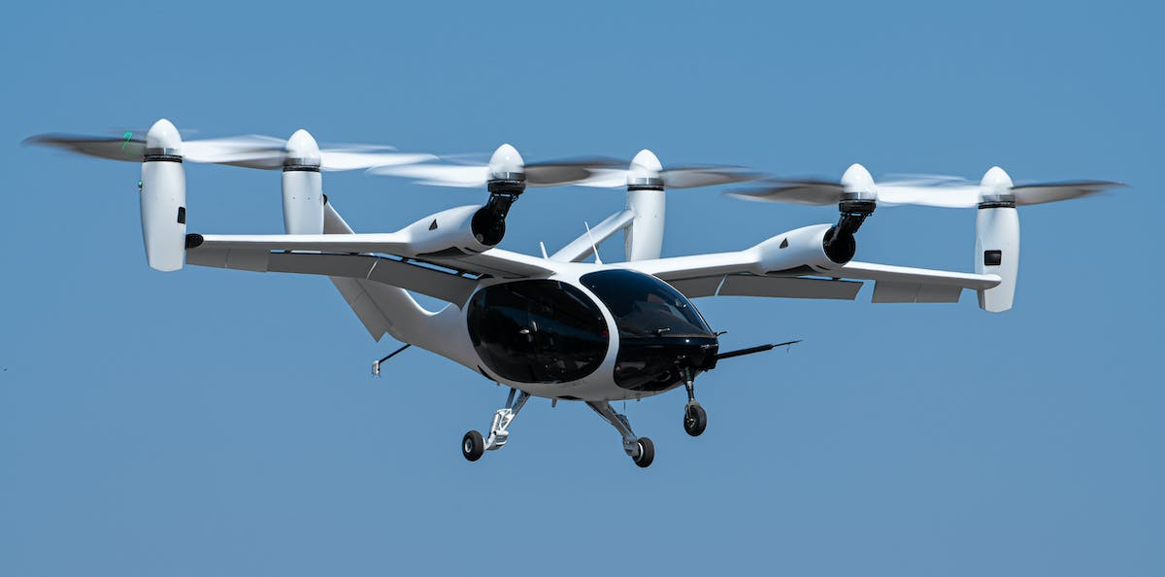
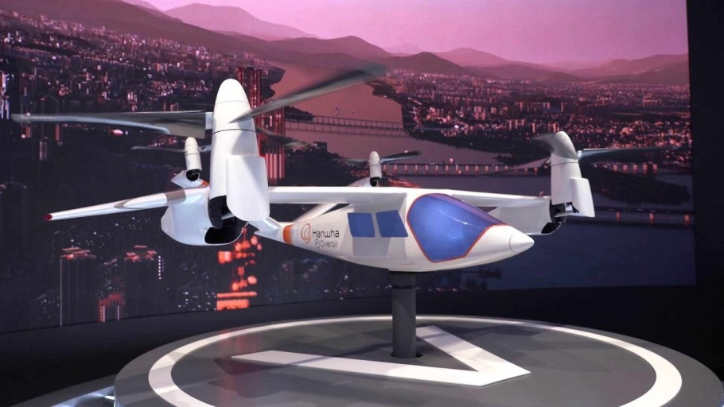
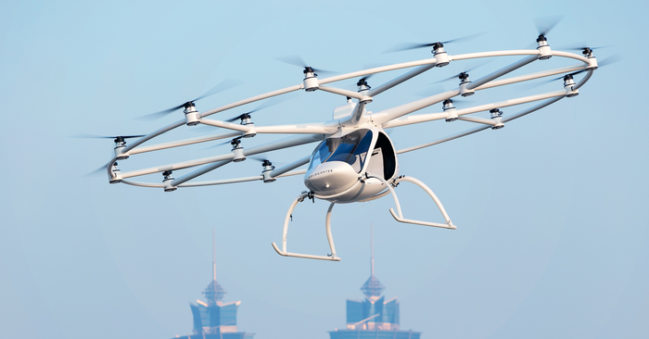
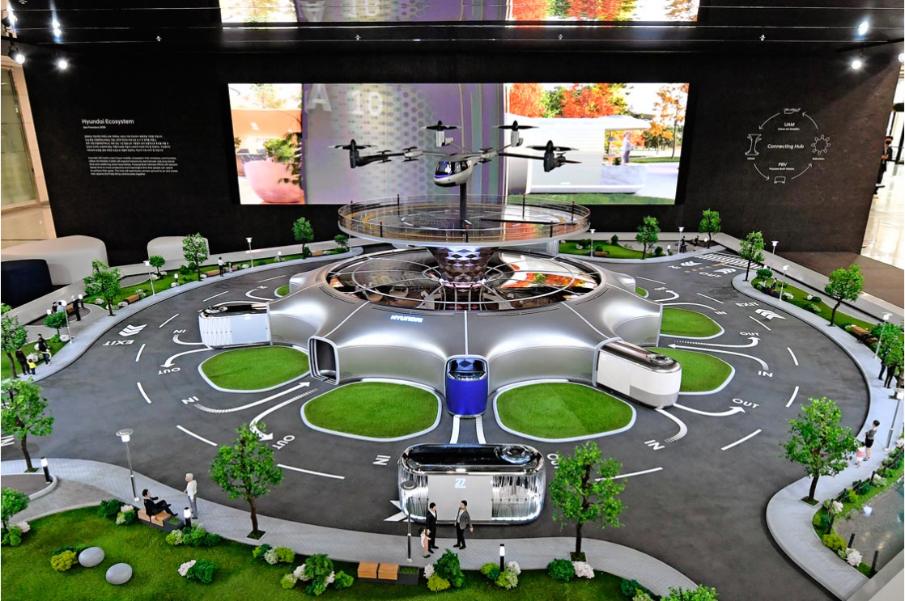
Status of UAM technology
Joby Aviation
Hanhwa Systems
Volocopter
Hyundai Motor

Slide 6
UAM Policy Issues
Vehicle configurations
Top-Level Aircraft Requirements
Range, Flight time, Passengers
Propulsion system
Vertiport installation
Air Traffic management (CNSi)
Seamless multi-modal transportation
Technology
Infrastructure
Societal considerations
Regulation
Noise, Visual pollution, Privacy
Safety
Market value estimation
Verification of Pilot and Manufacturer
AI based system automation
Unmanned system

Slide 7
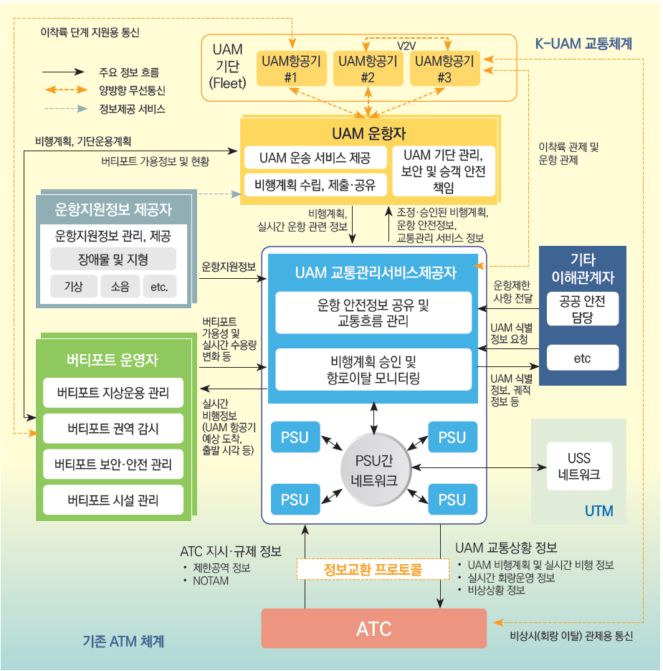
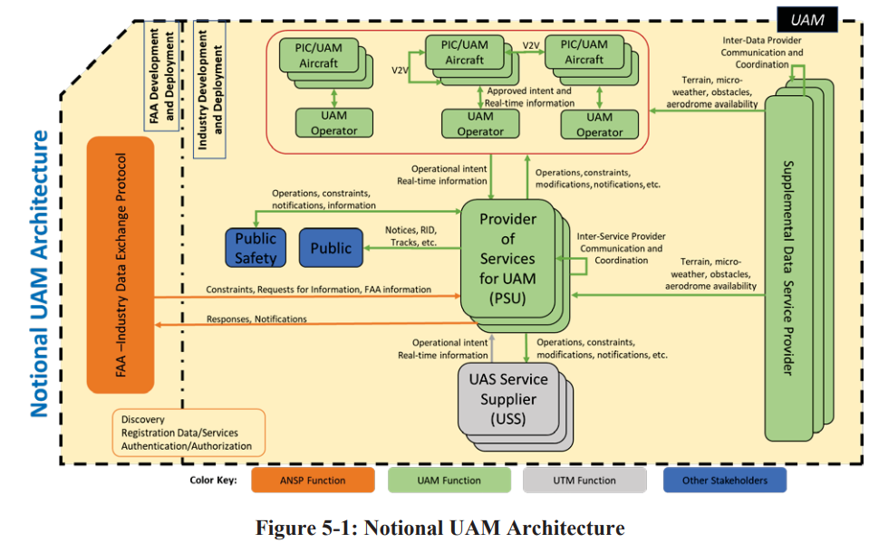
UAM Ecosystem: the Stakeholders
KAIA(2022), K-UAM Roadmap
FAA(2020), UAM ConOps v1.0

